Slide 1
Bitcoin Ben’s Crypto Club
Sarasota, FL
Presented by: Crypto Sherpa

Slide 2
Introduction
Welcome to the Bitcoin Ben Crypto Club, the premier community for cryptocurrency enthusiasts in Sarasota, FL.
Our club is dedicated to educating, empowering, and connecting individuals interested in Bitcoin and other cryptocurrencies.
Join us as we explore the exciting world of blockchain technology and help you navigate the crypto landscape.

Slide 3
Our Mission
Our mission is to foster a supportive and inclusive community where members can learn, share insights, and stay up-to-date with the latest trends in cryptocurrencies.
We aim to demystify the complexities of blockchain technology and empower individuals to make informed investment decisions in the crypto space.

Slide 4
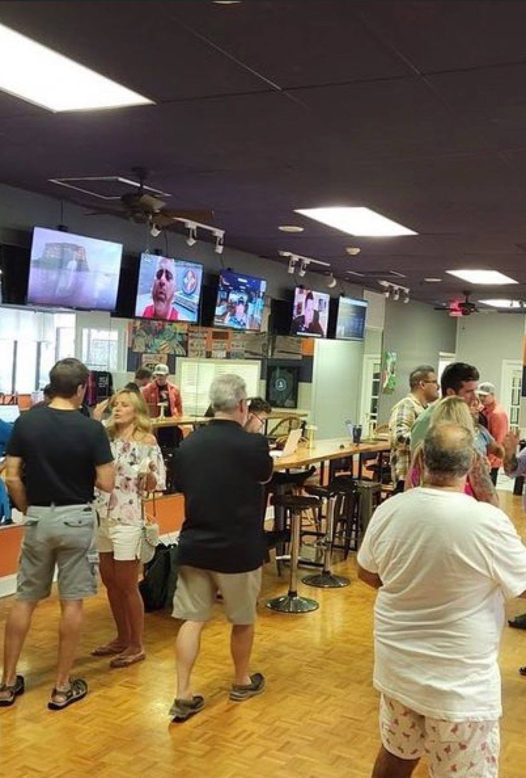
Why do people join the Bitcoin Ben Crypto Club
Exclusive Insights: Gain access to expert knowledge, industry insights, and analysis
Educational Workshops: Attend workshops and seminars designed to enhance your understanding of blockchain technology, cryptocurrency trading, and investment strategies.
Networking Opportunities: Connect with like-minded individuals, crypto enthusiasts, and industry professionals who share a passion for cryptocurrencies.
Portfolio Diversification: Discover opportunities to diversify your investment portfolio by exploring the potential of cryptocurrencies beyond traditional assets.
Ongoing Support: Benefit from ongoing support and guidance from experienced club members who are actively involved in the crypto space.

Slide 5
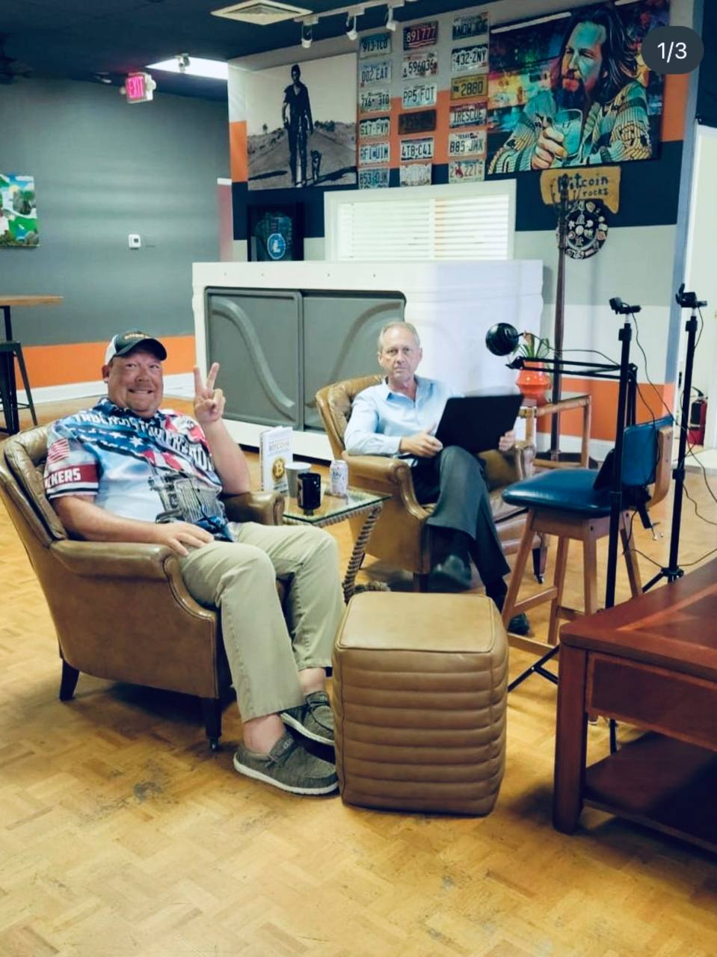
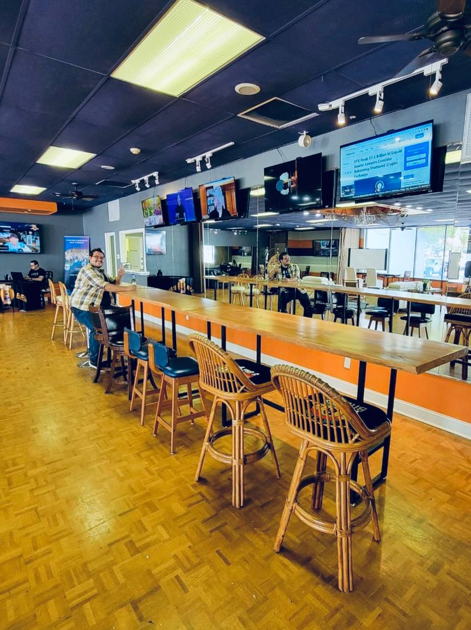
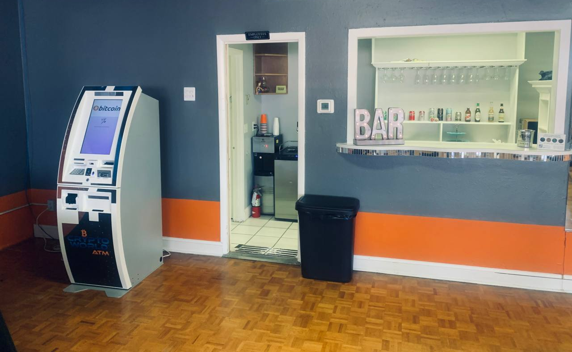
Membership Benifits
Weekly Meetups: Attend our Social Mixers every Thursday, where members can engage in discussions, ask questions, and share experiences related to cryptocurrencies.
Exclusive Webinars: Gain access to members-only webinars featuring industry experts, guest speakers, and Bitcoin Ben himself, discussing various crypto topics.
Market Updates: Receive regular market updates, analysis, and insights to help you stay informed and make well-informed investment decisions.
Office Space: Instead of working from home. The club has plenty of space for members to come in and set up shop.
Beverages: Drinks are included with all memberships. (Water, Soda, Coffee, Tea, Wine, & Beer)

Slide 6
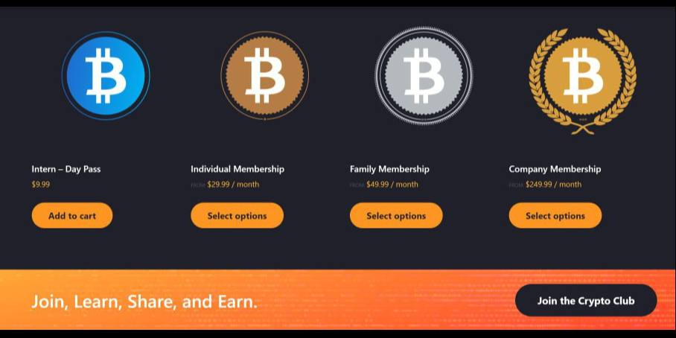
Revenue comes from our Membership fees

Slide 7
How much we’ve brought in since opening (3 Month Numbers)

Slide 8
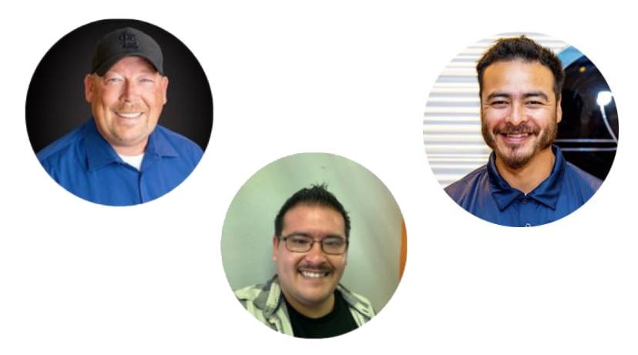
Our Team
Ben Semchee
Co-Owner
Bamboo Ben
CBO
Paul Bucci
Co-Owner

Slide 9
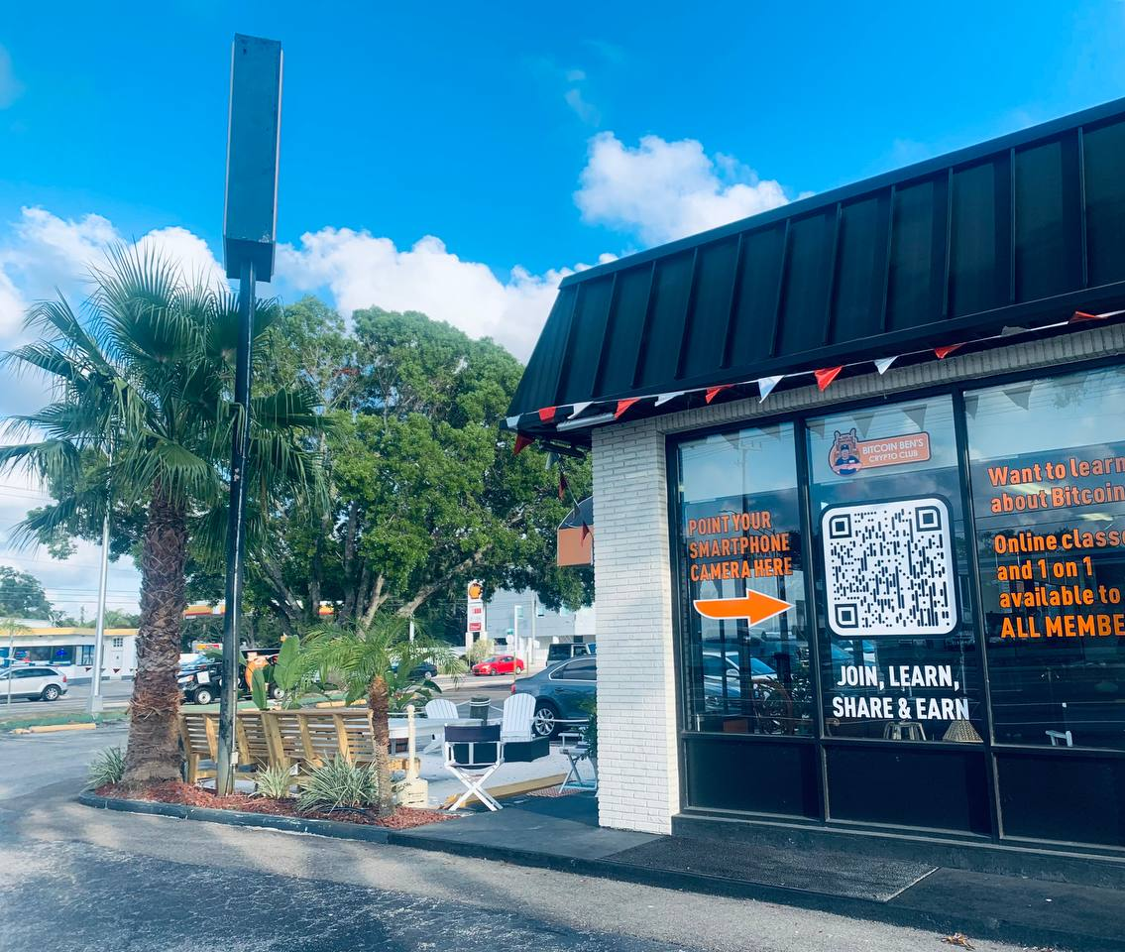
What We’re Offering
We are offering 10% equity in the Sarasota, FL location of the Bitcoin Ben's Crypto Club for $150,000.
This offer is only for the Sarasota location. Other clubs that open, will have other investors apart of that specific location.

Slide 10
Use of Funds
We will be dispersing the $150,000 out monthly through out the year. Using 50% towards Digital Ads, 25% towards Paper Ads, & 25% towards Physical Ads. All while using the Founders Group affiliate link, so when somebody signs up and becomes a member of the club from these ads. The Founders Group will be earning a percentage from each of those new members.
Digital Ads
Paper Ads
Physical Ads

Slide 11
Thank You!
contact@bitcoinbencryptoclub.com

